Slide 1
Job prospect
Wonder Philosophy 2019

Slide 2
Why think about it now?
Actually, it’s more important to think about it now than during your PhD.
What do you intend to do with a PhD? What if that doesn’t work out?
Are there things you could do you didn’t know about?
General rule: more backup plans allow for less strategic planning.

Slide 3
Types of academic jobs
Research job at an R1 institution
  Low teaching load + high research output demand
Research job at an R2 institution
  Greater teaching load + high research output demand
Secure teaching job at a 4-year university or LAC
  High teaching load + some research demand (depending on prestige)
Secure teaching job at a community college
  High teaching load + high administrative demand
Post-doctoral fellowship
Contract-based teaching job (adjunct)

Slide 4
Do you like research?
Most graduate students start graduate school liking research. And it is expected that you like research.
  It is *very* difficult to make it through grad school without liking research, even if you end up with a teaching/industry job.
R1 professors are expected to spend ~60% of their time researching (20% teaching and 20% administration).
Realistically, professors at R1s are almost exclusively evaluated based on research (up until Associate, at least).

Slide 5
Do you actually like research?
It is common to lose your interest in research momentarily or entirely during the grad school process.
  When that happens: there is nothing wrong with you. Research is the kind of thing you never know if you truly enjoy it until you try to do it for some time.
However, it is sometimes risky to express hesitation towards research in the profession, especially in prestigious programs/conferences.
  In fact, a good way to assess climate of a department is to see how many of its faculty/senior grad students openly express enthusiasm in teaching.

Slide 6
Do you like research that much?
On the other hand, it’s also hard if all you want to do is research.
  This is increasingly true now that there are more competent researchers than there are jobs.
Re: https://www.timeshighereducation.com/blog/if-you-love-research-academia-may-not-be-you
Pure research jobs are rare in philosophy.

Slide 7
The elusive R1
R1 jobs pay the most and have the most prestige, hence they are the hardest to come by.
According to APDA’s survey of Of 7,433 graduates (2011-2016):
  49% are in a permanent academic job
  33% are in a temporary academic job
  7% are in a nonacademic job
  12% have unknown placement.

Slide 8
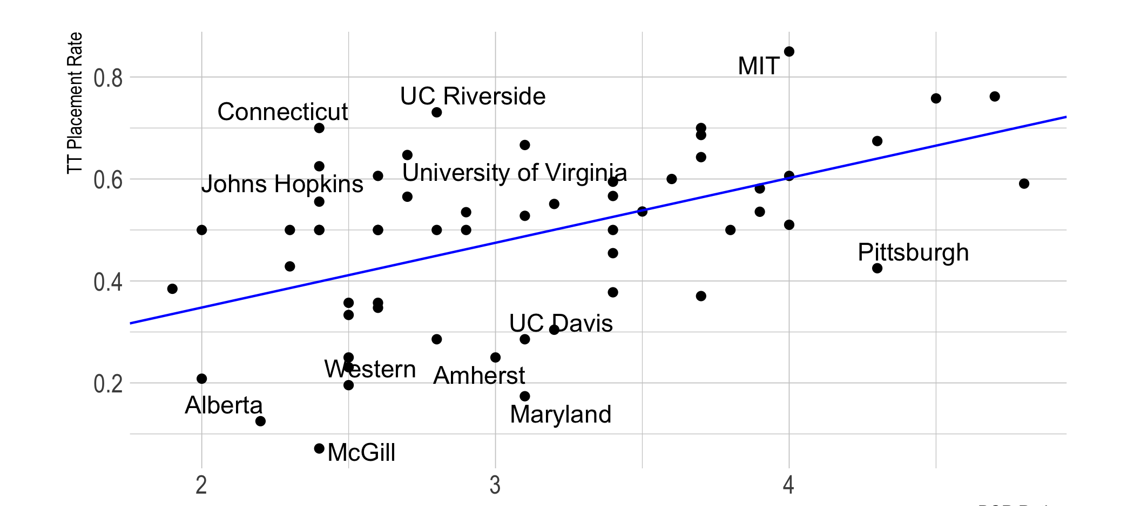
PGR-ranked prestige vs. TT placement rate (2012-14 grads)
Jonathan Weisberg, https://jonathanweisberg.org/post/prestige-placement/

Slide 9
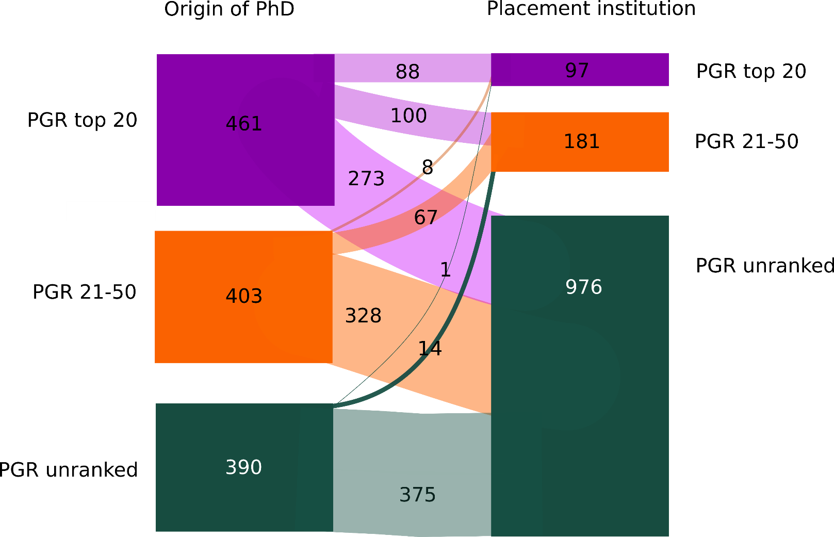
Analysis of placement of 2012-2017 graduates
Helen De Cruz, Prestige Bias: An Obstacle to a Just Academic Philosophy, https://quod.lib.umich.edu/e/ergo/12405314.0005.010?view=text;rgn=main

Slide 10
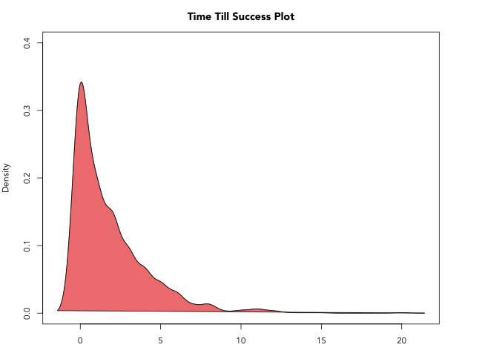
Average time from graduation to TT
Lee Elkin (ljelkin), https://github.com/ljelkin/jobplacement/blob/master/README.md?fbclid=IwAR249l8uXrAhLsGrwbQkwUIlShuI7KVxvVBbjbpbi1iiy-JU3_M8i3vL2Ls

Slide 11
The elusive R1: bottom line
There is a huge prestige bias.
  I have been told to not bother with not-PGR-top-20 schools because you won’t find a job. That’s a little extreme, but it certainly poses a challenge for top R1 jobs.
Even if you’re lucky to get an R1-TT, you most likely will end up at a school you’ve never heard of & don’t think is good.
It usually takes 6-7 years for a PhD and 2-3 years before landing a TT (assuming you’re lucky).

Slide 12
Do you like teaching?
Here’s the irony: you’re not supposed to like teaching throughout graduate school, but you have a much better job prospect if you’re willing to teach.
Teaching jobs come in different degrees of prestige, too.
  Prestigious Liberal Arts College (LAC)
  Other SLAC
  Community College (CC)
It is actually really hard to find good data on teaching (because the majority of the profession doesn’t care about it).

Slide 13
How much do you like teaching?
Prestigious LACs usually require competitive research profiles as well as demonstrated teaching excellence.
CCs: low pay, high teaching & administrative demands, usually poor classroom facilities.
  However, if you’re geographically constrained, CCs/not-prestigious SLACs give you the best chance to support yourself where you want to be.
  (You might not think you’re geographically constrained now but that might change.)

Slide 14
How to be competitive for teaching jobs
Most prestigious (and probably many non-prestigious) programs aren’t good at supporting students for teaching jobs. So you need to plan for yourself.
Take courses widely & especially in mainstream topics. Even if your dissertation is on bioethics, you will have to teach: traditional ethics, political philosophy, critical thinking, M&E, Descartes.
Look into teaching certificate programs early in your career. Many schools offer some form of it but it may take some time to complete.

Slide 15
Going into PhD with the goal of teaching
While it’s possible that you may start loving research and hating teaching as you progress in your graduate career, I have seen more people moving in the opposite direction.
If you are serious about wanting to teach, I recommend making it a priority when you visit programs.
Ask faculty about campus teaching opportunities and see how much they know; ask whether they have experience placing teaching-focused students.
https://philosopherscocoon.typepad.com/

Slide 16
What is an adjunct?
Adjunct professors are typically hired:
  On a contract-basis: no job security
  As part-time: no benefits
  With lower pay grade: sometimes below hourly minimum wage & below poverty line
  As non-voting members: are not involved in departmental decision making; typically creates a sense of isolation.
The treatment of adjuncts varies vastly across schools, but most (big) schools treat their adjuncts poorly. Adjuncts are also often not unionized.

Slide 17
Why do people adjunct?
Adjunctships are easy to get. They are often hired to teach intro-level large classes at big schools.
  Many big schools don’t care about their undergrad quality of education very much, which means they sometimes don’t screen for adjunct qualification as rigorously.
Sometimes adjuncting is the only way to pay the bills at hand.

Slide 18
Some good reasons to adjunct
Some senior graduate students adjunct as a way to 1) supplement paycheck, 2) acquire teaching experience.
  E.g., yay Alysha and her Cal State Fullerton crew!
  Adjuncting as a student is a great way to be more competitive in the teaching market.
There are permanent adjunctships too.
  They are not common but good if you just want to teach and not do research or administration.
Some places pay adjuncts reasonably well with reasonable security. It’s one feasible way to live where you want to live while supporting yourself with philosophy.

Slide 19
Some bad reasons to adjunct
Very often, though, students start adjuncting after graduation because they didn’t find other jobs and needed to support themselves.
Most adjunctships are very time-consuming with little pay, leaving no time to build a more competitive research profile
  I know someone who’s rumoured to juggle 3 adjunctships and has a 60-hour weekly workload of teaching alone.
Unfortunately, the adjunct problem disproportionally hits low-income students because they are more likely to have to immediately support themselves after graduation.

Slide 20
Plan B
According to the APDA, 33% of students graduated between 2011-2017 were in temporary positions in 2017.
  This includes post docs, of course, but it’s still a big number.
In general, it is worth thinking about what you would do to support yourself if the job search doesn’t work out for a couple of years after you graduate.
Relatedly, remember also that only about half of admitted students finish their PhDs.

Slide 21
Questions?

